Slide 1



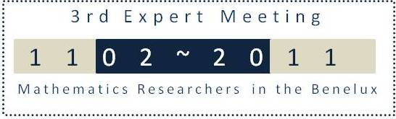

Exploring number discrimination abilities from infancy to toddlerhood
Annelies Ceulemans, Annemie Desoete, Karel Hoppenbrouwers, Karla Van Leeuwen

Slide 2

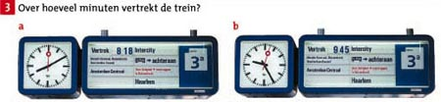
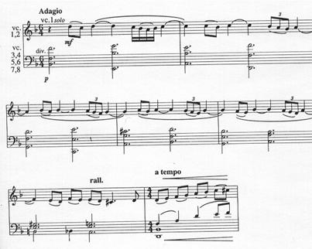

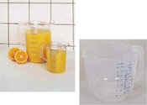


Numbers are everywhere

Slide 3


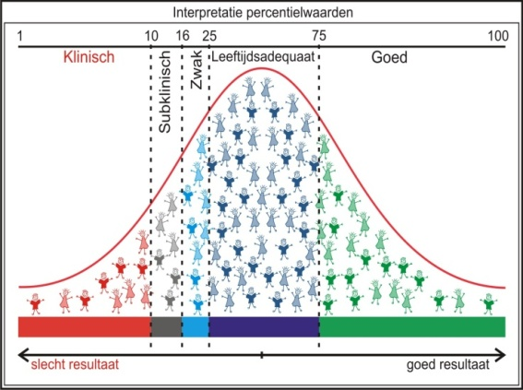
Problems with numbers? Dyscalculia
CRITERIA
1. Below average mathematics (≤ pc 10)
2. RTI
3. Exclusion criterion
Logopedie, 23 (4), 4-9
Introduction
Study 1
Study 2
Conclusion

Slide 4
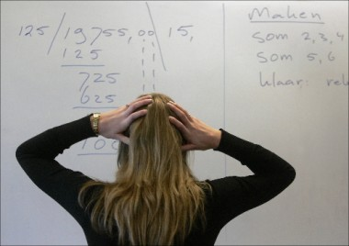

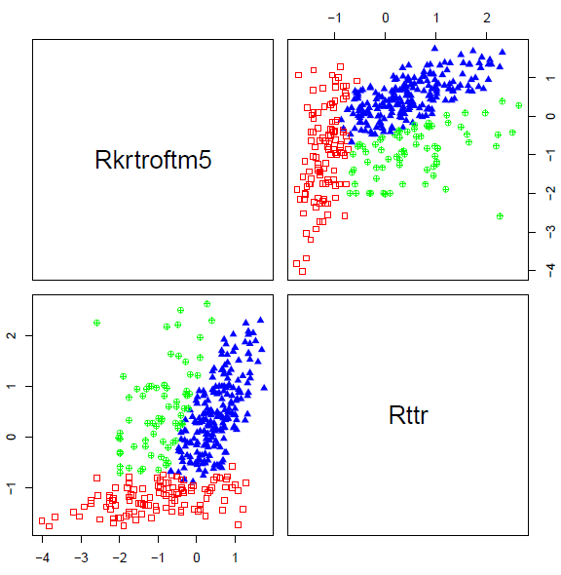
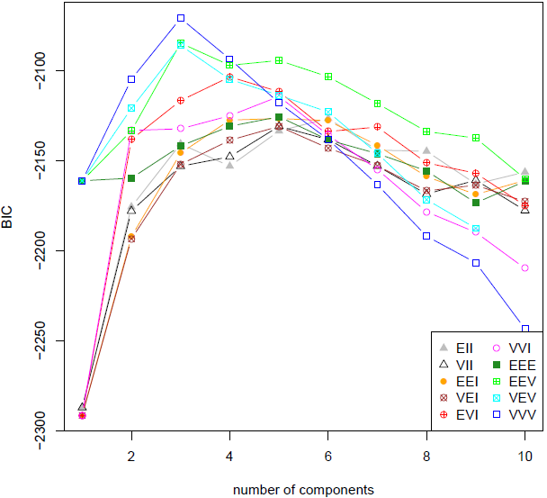

N=410
TTR en KRT-R
Has every one the same problems?
Stefanie Pieters Ugent
Introduction
Study 1
Study 2
Conclusion

Slide 5

Procedural/ semantic memory deficit
TTR en KRT-R
Number of observations per cluster:
1 2 3
209 112 70
Mean patterns per cluster:
[,1] [,2] [,3]
KRT-R 0.4739268 -1.027120 -0.7609023
TTR 0.3946649 -1.179546 0.3834001
Dyscalculia +/- dyslexia? EF
Phd. Frauke De Weerdt
Control group
Sem. Memory DC
Procedural DC
+ Spelling deficit
5
Introduction
Study 1
Study 2
Conclusion

Slide 6
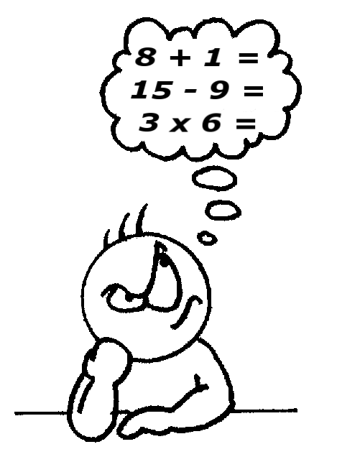
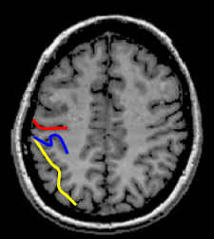
Dyscalculia: core deficits number sense ?
2 4
2 4
Introduction
Study 1
Study 2
Conclusion
Notes:
6

Slide 7
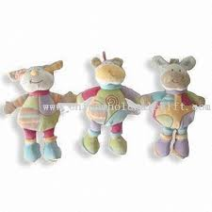
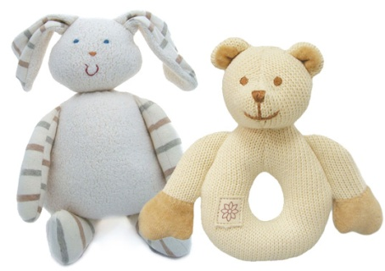
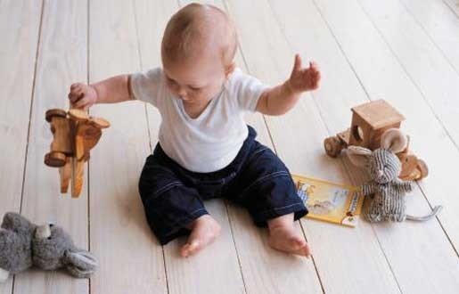
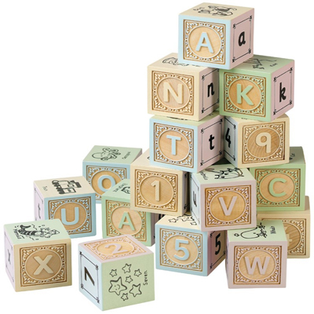
Number discrimination in baby’s?
Can we predict dyscalculia in baby’s?
PhD Annelies Ceulemans
Introduction
Study 1
Study 2
Conclusion
Notes:
7

Slide 8


How we see differences between numbers?
Barner, Thalwitz, Wood, Yang, & Carey, 2007; Cordes & Brannon, submitted; Xu, 2003
Number discrimina
tion
Analogue magnitude
Object-file
Small number
Large number
< 4
> 4
Introduction
Study 1
Study 2
Conclusion
Notes:
8

Slide 9


2 systems to discriminate number: Discrete vs continuous
1
3
Discrete vs Continuous
Discrete: e.g., Xu, Spelke, & Goddard, 2005
Continuous: e.g.,Clearfield & Mix 2001; Rousselle, Palmers, & Noël, 2004
Number discrimination
Analogue
Magnitude: approximate representation
Object-file
Exact representation
Small
numbers
Large
numbers
(Kahneman & Treisman, 1984; Leslie, Xu, Tremoulet, & Scholl, 1998)
< 4
≥ 4
(Feigenson, Dehaene, & Spelke, 2004)
Introduction
Study 1
Study 2
Conclusion
Notes:
9
Previous studies in infants revealed that these children rely on two systems to discriminate number.
Small numbers on the one hand seem to be processed with an object-file system which allows infants to have a discrete, exact representation of a limited number of items (≤ 3). Large numbers (>3), on the other hand seem to be processed by a system which allows children to have an approximate representation of number. Number discrimination in this case is ratio-dependent, which means that it matters how two numbers are related to each other. The bigger the distance between the two numbers, the easier they can be discriminated.
Infants would have access to both systems, but probably it depends on the task which system is triggered. The fact that children discriminate small numbers has mostly been shown by studies using a manual search task. The habituation task mostly gives evidence for the discrimination of large numbers. However, recently one study has found that infants discriminate the small numbers two and three, which is in contrast with a previous finding that infants cannot discriminate one from two.
Both the manual search task and the habituation task will be explained later on.
A question that we can ask is whether children discriminate numbers using the number of items which is a discrete variable or the amount of space or total size of the individual items all together which are continuous variables. These continuous variables vary with number if the exact same stimuli are used to present different numbers in one comparison. For example: someone can see the difference between these sets of dots because he knows that this is one dot and these are three dots. However, someone can also see the difference by using the total size of the items or the total occupied area, which is in both cases bigger for the set of 3.
Therefore it is important to control these continues variables and by doing this ruling out the possibility that infants would use these continuous variables rather than using the discrete variable of number instead.

Slide 10
Number discrimination: Individual differences
Group performance
Individual differences
Number discrimination
small
numbers
large
numbers
Object-file
Analogue magnitude
Introduction
Study 1
Study 2
Conclusion
Notes:
10

Slide 11
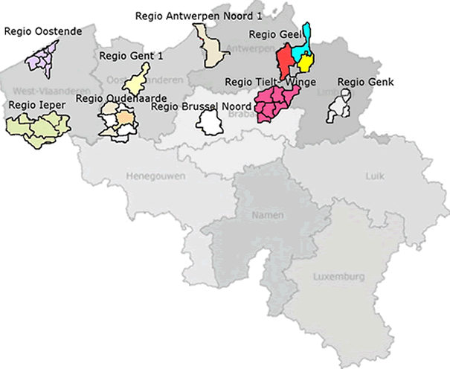
Study I (n = 87) cross-sectional
0m,8m,12m,18m,24m,28m → 36 m
(n = 3017 stratificated larger sample)
° may 2008 – april 2009
n = 3017 → 10% ‘cases’
31-38 week old (8-9m)
Introduction
Study 1
Study 2
Conclusion
Notes:
First, I will present the results of the cross-sectional study with the infants of 8&9-month-olds.

Slide 12
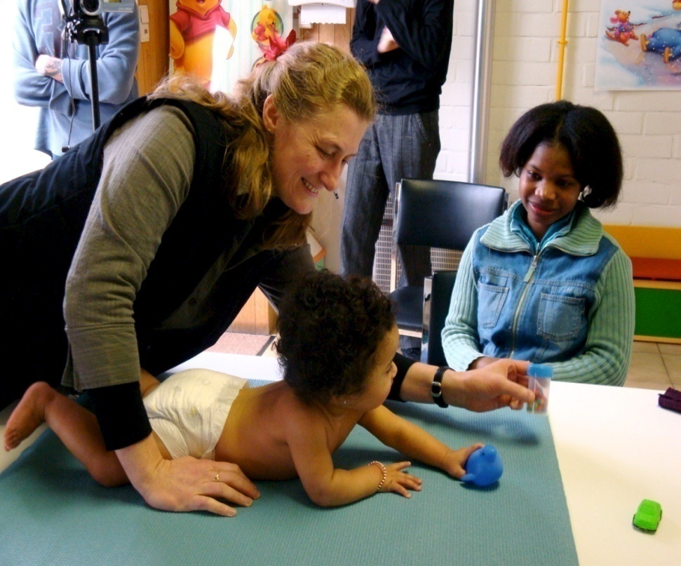
A.PARENT
C.Pre- en perinatal ad risc factors
D.CHILD
Demographical characteristics
Mental health
Demographical charactistics
Health
Development
Temperament
Behaviour
Pregnancy, birth
Way of life mother
B.FAMILY
Demographical characteriistics
Members in the family
Fuctioning of the members
Health events
E. EDUCATION
Educational behaviour
Educational values …
F. CONTEXT
Social netwerk
Child care
School
G. CARE
Need for care Use of care Care traject
SWVG - Beleidsplatform 27 januari 2009
Notes:
12

Slide 13




















Habituation Paradigm (procedure)
Habituation phase: 6 displays – until habituation or 14 trials
Test phase: 3 displays – 3 test trial pairs: old & new number
Introduction
Study 1
Study 2
Conclusion
Notes:
13
In this task following the habituation paradigm children see a specific number of visual stimuli (mostly dots) until they get used to it or, in other words, are habituated to it. Therefore six different displays of either three or one dots were repeatedly shown in random order during this habituation phase. If infants did not habituate a maximimum of 14 habituation trials was given.
Afterwards, in a test phase they saw in alternating order, the habituated number (or old number) and a new (and thus not habituated) number during 6 test trial pairs, resulting in three test pair containing a display of and old and a new number. The order of the number which is shown first is also counterbalanced.
It is expected that children look longer at the novel number in the test phase, which is considered to be an indication of discriminating the numbers of items.

Slide 14
Habituation Criterion
H50 % decline in total looking time on 3 consecutive trials, relative to the first 3 trials
Total: 9 sec
Introduction
Study 1
Study 2
Conclusion
Notes:
14
Een kind is gehabitueerd wanneer het zolang kijkt naar drie opeenvolgende trials zodanig dat dit gelijk of minder is dan de helft van de kijktijd naar de eerste drie trials.
Bijvoorbeeld als een kind 9 seconden kijkt naar de eerste drie trials, dan is het kind gehabitueerd wanneer het 4,5 of minder dan 4,5 seconden kijkt naar drie opeenvolgende trials.
In dit geval is het kind gehabitueerd na de 8ste trial: omdat de som van de kijktijden naar trial 6,7 en 8 gelijk is aan minder dan de helft van de 9seconden die het kind keek naar de eerste drie trials.

Slide 15
3 studies - age 8 m.
  Study 1: small numbers 1vs3
  Study 2: large numbers 4vs8
  Study 3: small and large number 1vs4
  Group vs. Individual performances!
Small number
small
large
Large number
Introduction
Study 1
Study 2
Conclusion
Notes:
15

Slide 16
Participants
≠ 1 vs 3
≠ 1 vs 4
≠ 4 vs 8
N | 36
Age | 31 | 38
M (age) | 34.67 (SD: 2.24)
Sex | ♀ | ♂
N (sex) | 17 | 19
N | 26
Age | 33 | 38
M (age) | 35.73 (SD: 1.56)
Sex | ♀ | ♂
N (sex) | 14 | 12
N | 25
Age | 33 | 38
M (age) | 36.32 (SD: 1.57)
Sex | ♀ | ♂
N (sex) | 10 | 15
small
small
large
large
Notes:
16

Slide 17
≠ group
1vs3
1vs4
4vs8
*
*
LMM
F(1,34.22) = 16.11, *p < ,05
LMM
F(1, 25) = 23.57, *p < ,05
LMM
F(1, 24) =
2.31, p > ,05
Notes:
17

Slide 18
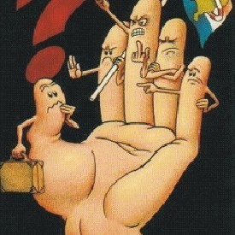

Individual ≠: who’s at risk?
Introduction
Study 1
Study 2
Conclusion
Notes:
18

Slide 19
Study II (n = 15) : longitudinal study
8 → 36 month-olds
(n = 3017)
Introduction
Study 1
Study 2
Conclusion
Notes:
In the following part, I will discuss the results of the 2nd study, namely the longitudinal study in which we saw the children from study I again at the age of 24 months.

Slide 20
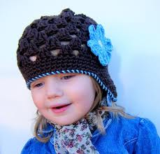
METHOD: Procedure
  Children on the parent’s lap in front of a table
  Experimenter behind the table
  Video camera recorded side-view and overview
  Manual search task (1vs3)
    based on manual search paradigm according to Feigenson & Carey (2003)
    Stimuli were green-coloured balls
Introduction
Study 1
Study 2
Conclusion
Notes:
For this task children sat on the parent’s lap in front of a table behind which the experimenter was seated.
The session was video recorded from the side and from above to get an overview of the setting.
The task itself was a manual search task based on the manual search paradigm according to Feigenson and colleagues.
Stimuli were green-coloured balls.
20

Slide 21






Manual Search Task (procedure)
  Box placed on table.
  1 ball on box, then hided.
  Infant allowed to retrieve
  1 ball.
  1-object (exp.empty) trial
  Box placed on table.
  3 balls on box,then hided.
  Infant allowed to retrieve
  1 ball. Other 2 removed.
  3-object (2remaining) trial
  Sequence of trials: repeated once more :1st & 2nd round
  After each trial: measurement period of 10 sec
  Searching time coded from video
Introduction
Study 1
Study 2
Conclusion
Notes:
21
In tasks according to this paradigm a box is used with a slit at the face of the box in which both researcher and child could insert their hand. This side of the box was placed in front of the child. The other side was open covered with a small curtain, through which the researcher could put his hand in the box without the child seeing it.
The concept is that a researcher places some balls into the box during the first phase in this case one ball. Afterwards children are allowed to retrieve the ball.
This is the 1-object expected empty trial because the children can retrieve all hidden balls.
In a second trial the researcher hides three balls, whereafter the child was possible to retrieve only one ball, because the researcher took away the other two balls without the child seeing it. Because the child cannot find back all the hidden balls, this trial was called the three-object two-remaining trial.
In a third trial then the experimenter gave back the two balls that were left. This was the three-object (expected empty) trial.

Slide 22

RESULTS: Group Level
Significant effect
of trial type:
longer searching after more remaining trials than expected empty trials
GLM- repeated measures
Type: F(2,12) = 4.30, *p < .05
Introduction
Study 1
Study 2
Conclusion
Notes:
Results at group level revealed that there was a significant effect of trial type on the searching time of the infants.
This is: searching time after the more remaining trials was significant longer than searching times after the expected empty trials.
This was the case for both trial rounds of the manual search task.
22

Slide 23
RESULTS: Individual Level
Introduction
Study 1
Study 2
Conclusion
Notes:
Also in this study we can devide the children in groups according to their performance. Similar to our analysis in study I, we look at the possible difference scores that children can have in the two rounds of the manual search task:
The difference between the searching time after the more remaining minus the first expected empty trial.
The difference between the searching time after the more remaining minus the second expected empty trial.
All together this gives a total of four possible difference score.
Some children achieved a total of four positive difference scores and thus searched longer in each more remaining trial.
Other children had only two positive difference scores.
Because there were no infants with four negative scores, the infants which are of most interest in this case are those three who had three negative difference scores.
23

Slide 24
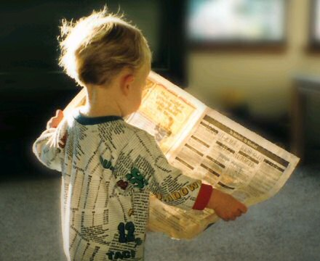
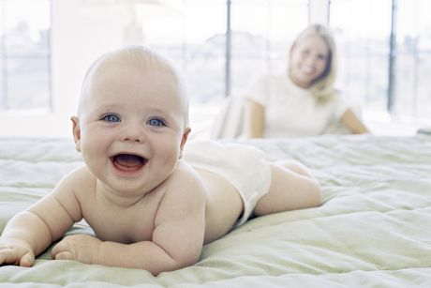
  8 m. habituation → 24 manual search task
  1 vs. 3
  3 children at risk at 24 months
  1 child at risk at 8 and 24 months
  2 new children at risk at 24 months
Introduction
Study 1
Study 2
Conclusion
Notes:
To summarize: we had a first research moment at which children received a habituation task and a second at which they got a manaul search task.
Results revealed 16 children at risk at the age of 8&9months with the habituation task.
One child of these 16 infants had also a risk-score at the age of 24 months with the manual search task.
Furthermore we could identify to new children at risk at the second research moment.
24

Slide 25

General Conclusion
  Exploring the individual level:
    divide infants into higher & lower performers
  Study 1: 1 vs 3/ 1 vs 4 (not 4 vs 8) on 8 months
    At-risk: 20 children (n = 87)
    Most children problems with 1 vs. 3
  Study 2: 1 vs 3 on 8 and 24 months
    At-risk: 3 children (n = 15)
    At child at-risk at both moments: real risk?
    At-risk at 2nd research moment: stagnation?
Further longitudinal research:
→ number discrimination as screening variable?
Introduction
Study 1
Study 2
Conclusion
Notes:
25

Slide 26

More information
annelies.ceulemans@ugent.be
annemie.desoete@ugent.be
http://www.steunpuntwvg.be

